Slide 1
Illustrations
Introduction to LabBench

Slide 2
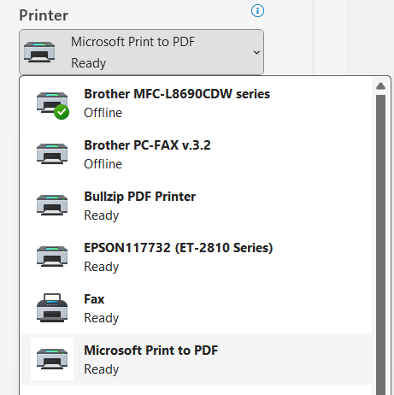

Slide 3
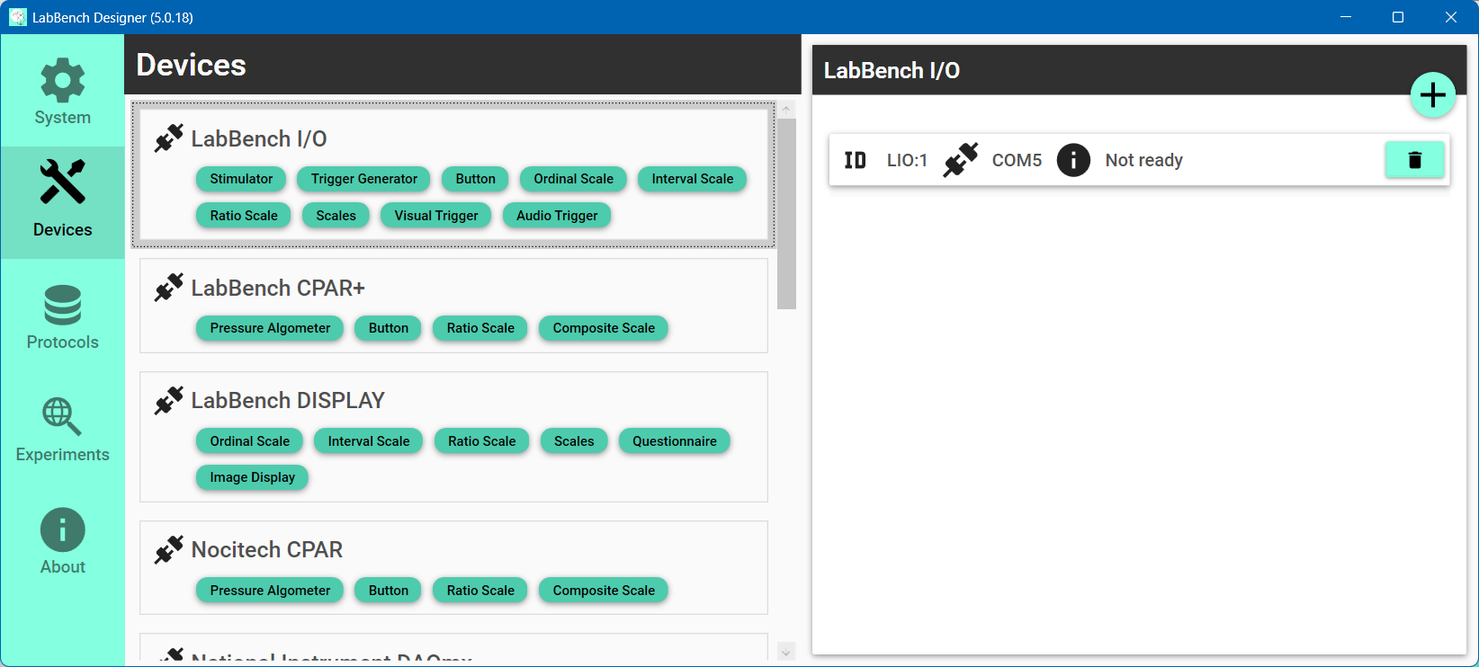

Slide 4

Select the Devices page
Click the “Scan and add” button
Select the type of instrument to add

Slide 5
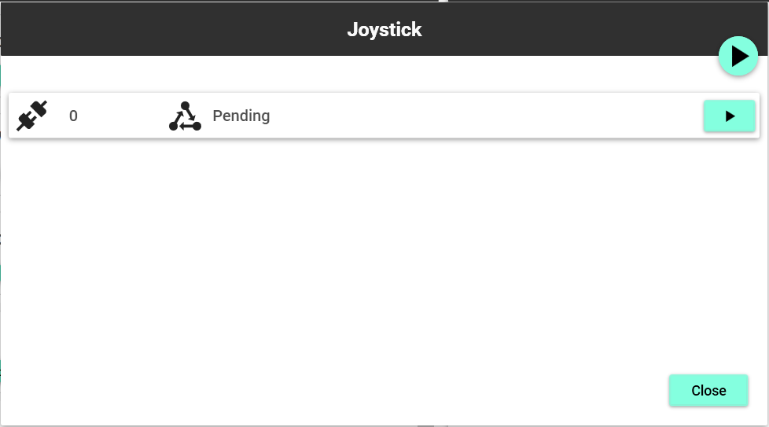
“Scan all connections” button
“Scan connection” button

Slide 6
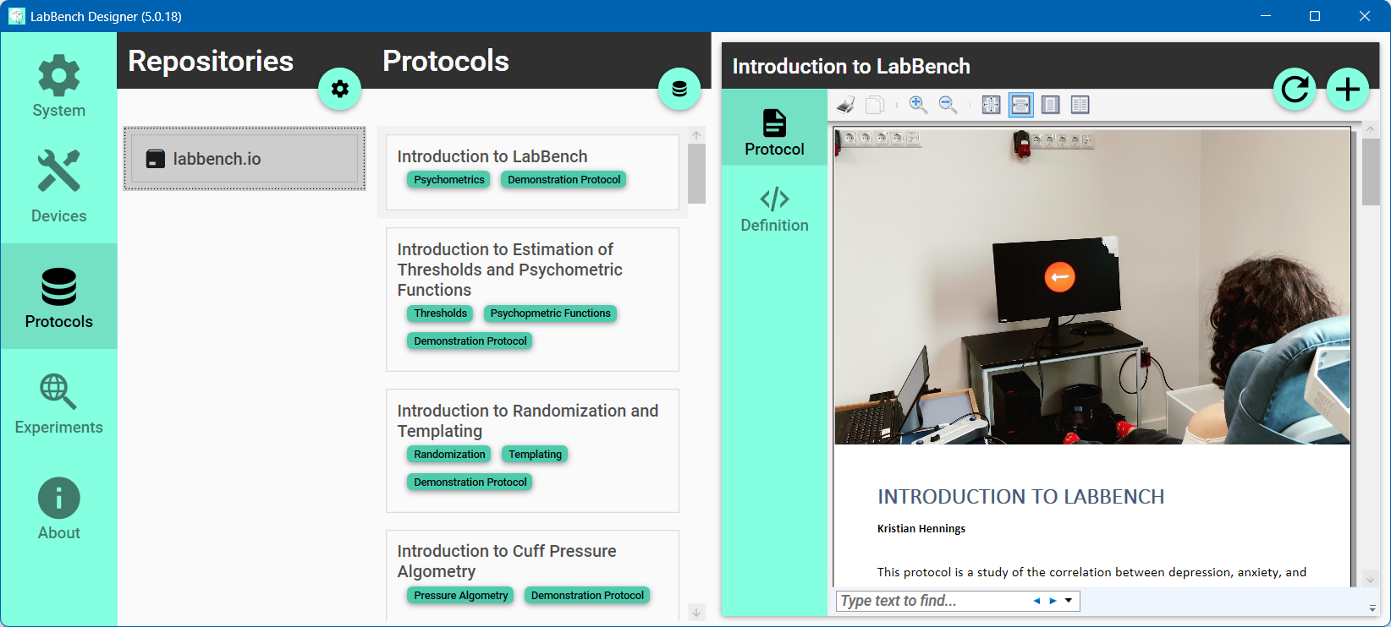
Select Introduction to LabBench
Select the Protocols page
Click the “Install protocol” button
Select the labbench.io repository
Notes:
Joystick Experimental Setup

Slide 7
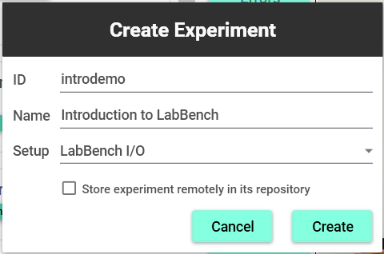
ID of the experiment that must be unique
Name that is displayed to the experimenter
Experimental setup variant
Store the protocol in the repository
Click to create the experiment

Slide 8
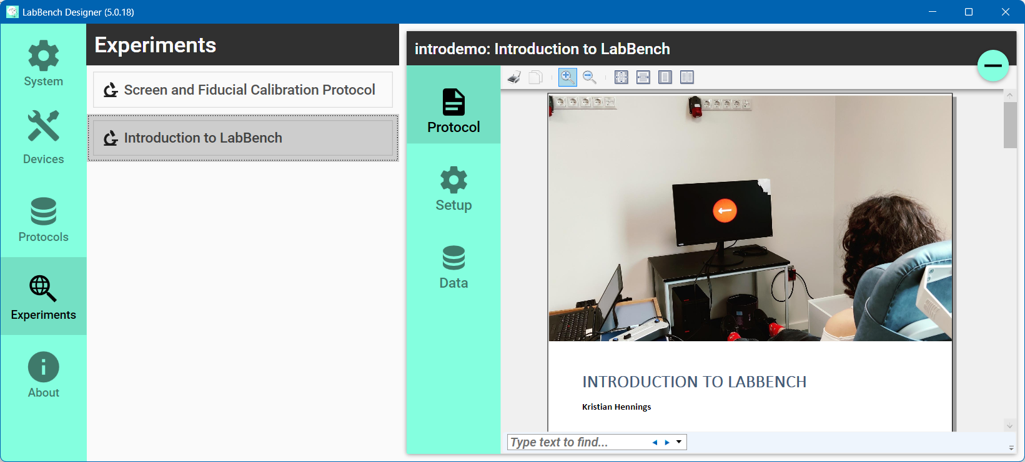
Select the experiment to mange
Select the Experiments page
Content of experiment page
Select the experiment page

Slide 9
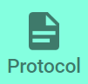

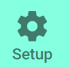




Slide 10
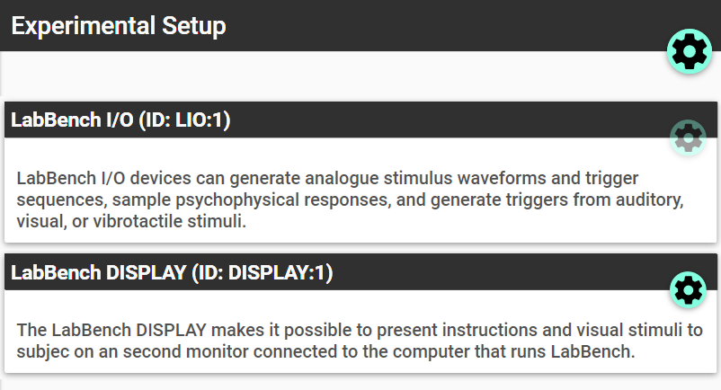
Assign equipment
Configure device

Slide 11
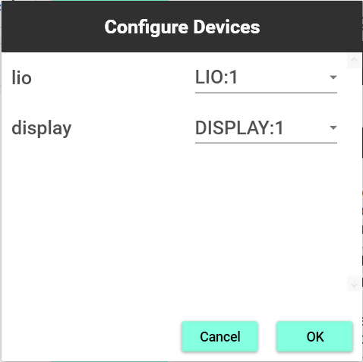
ID of the device in the protocol
Equipment ID from the Devices Page

Slide 12
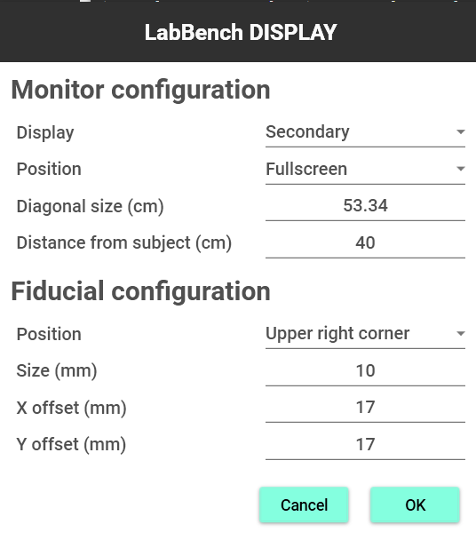

Slide 13
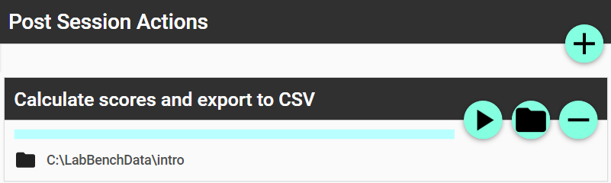
Rerun action
Change output directory

Slide 14
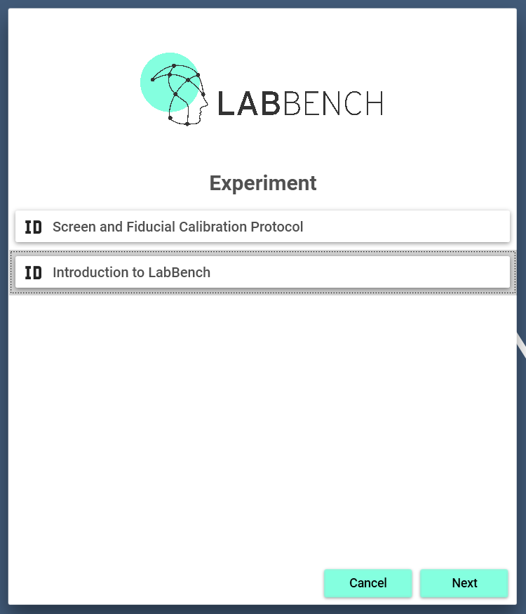

Slide 15
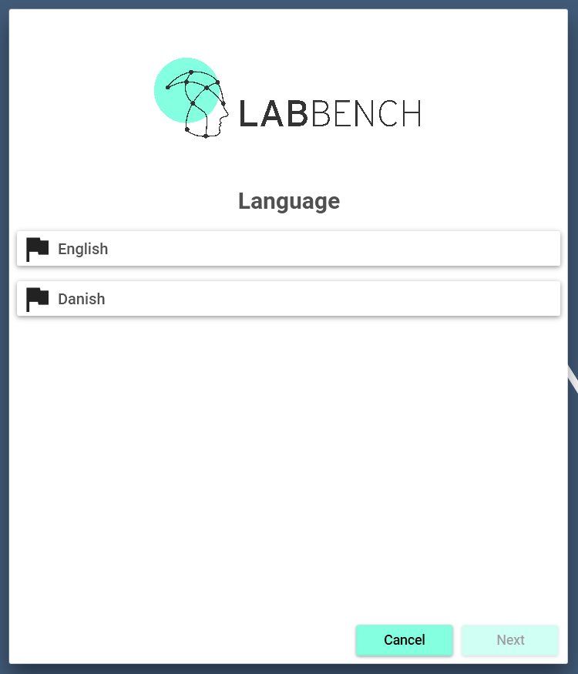

Slide 16
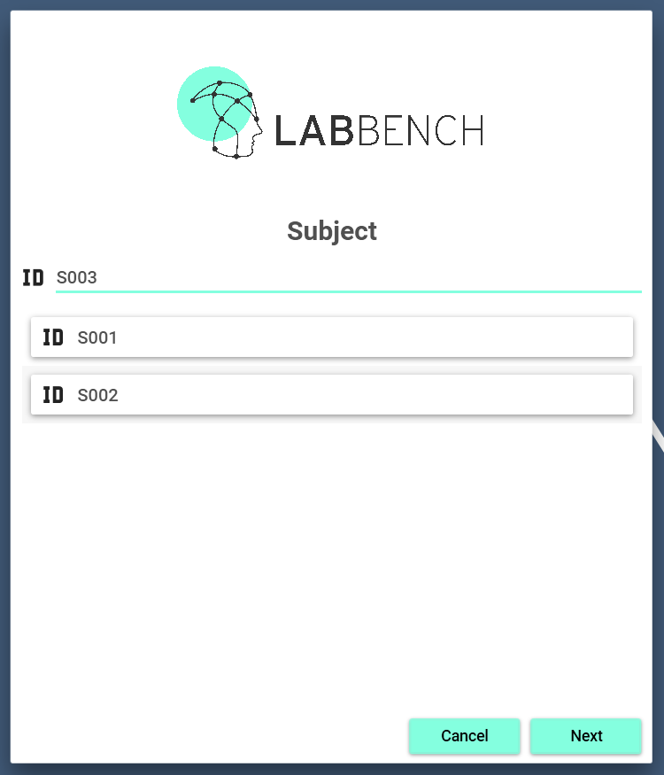

Slide 17
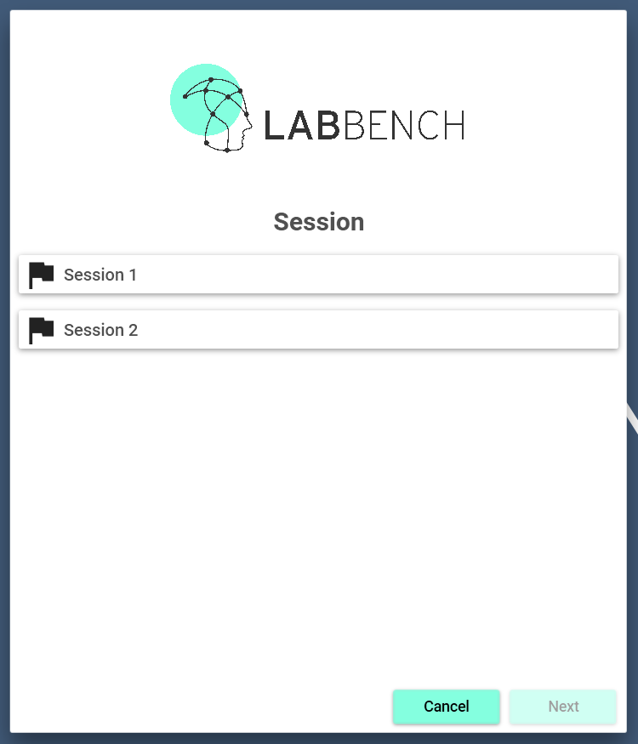

Slide 18
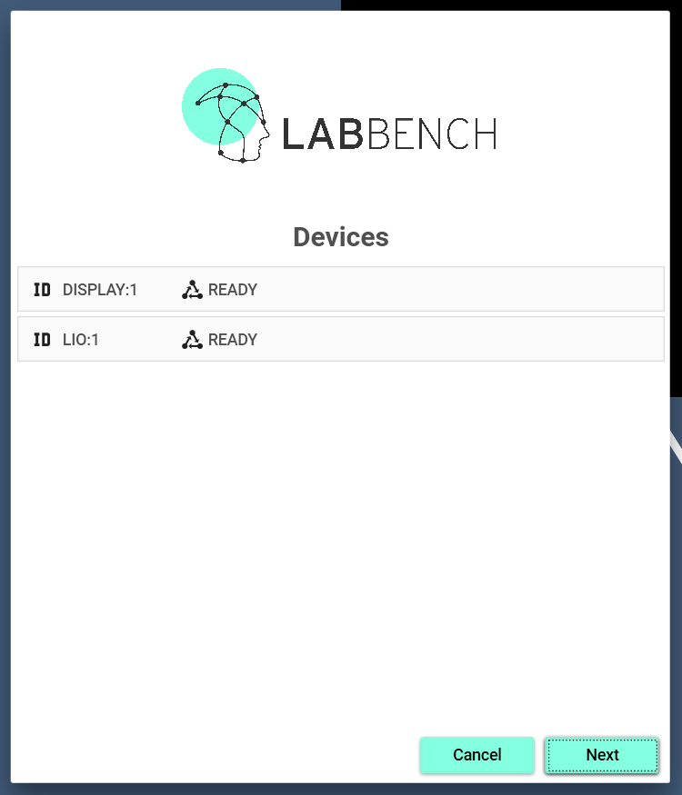

Slide 19
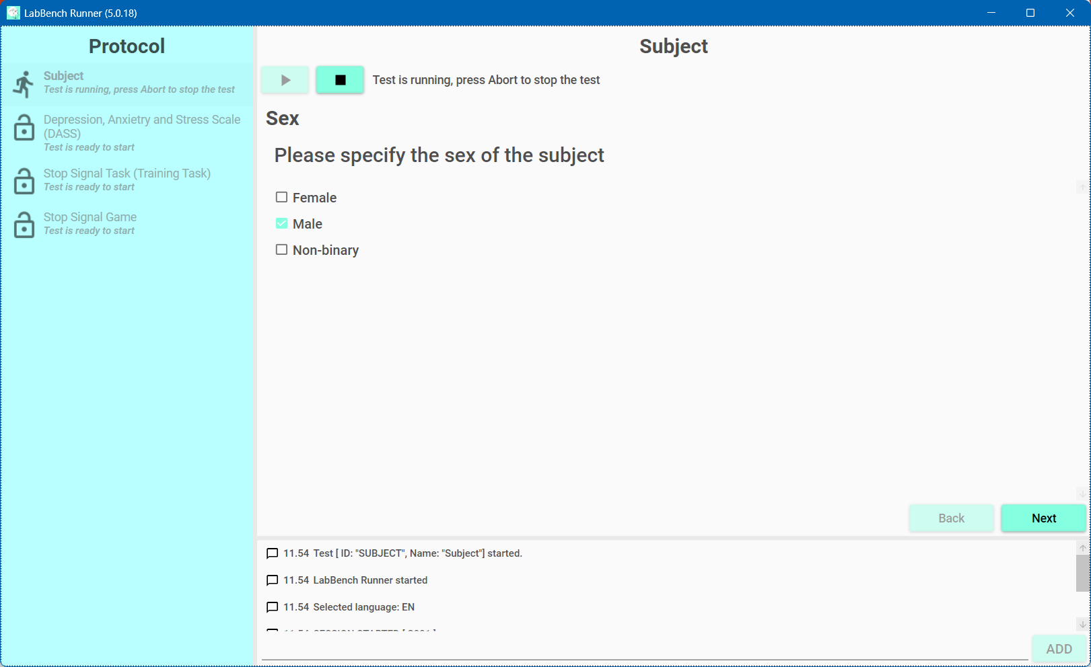

Slide 20
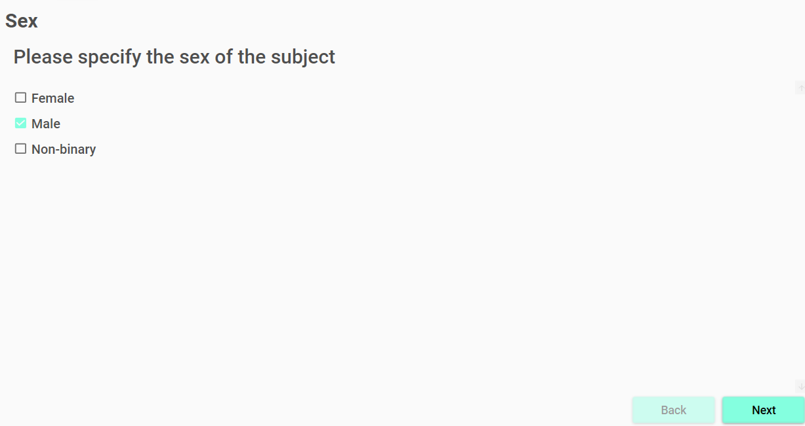

Slide 21
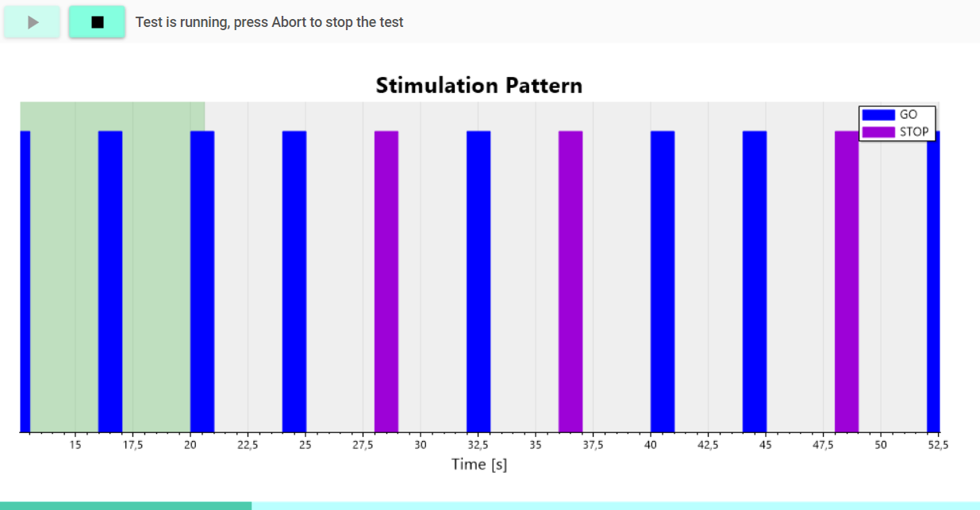

Slide 22
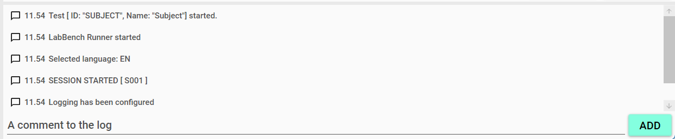

Slide 23
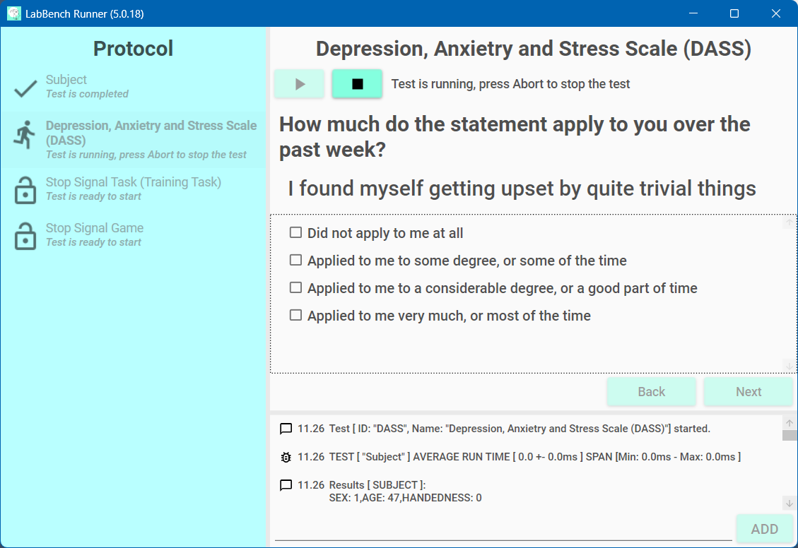

Primary Screen
Secondary Screen (LabBench Display)

